Slide 1
Revision: The Cosmic Engine

Slide 2
What we’ll cover
The Big Bang and the formation of stars and galaxies
Nuclear chemistry and the characteristics of α, β, and γ radiation
Blackbody radiation and stellar luminosity

Slide 3
Star and galaxy formation summarised
Big Bang (BB):
Matter and antimatter, and resultant annihilation
BB + 300 000 years:
A lumpy Universe, with gas clouds separated by vast distances. Gas clouds were themselves lumpy
BB + 10⁶ – BB + 10⁹ years:
Within protogalaxies (gas clouds), accumulation of matter at denser parts of cloud occurs. Gas clouds spinning as a result of matter/antimatter annihilation and forces associated with BB
Later:
Flattening of gas clouds, rotation increases with aggregation of further matter, star and galaxy formation

Slide 5
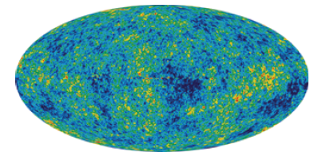
Evidence for the Big Bang
Cosmic background radiation – predicted by Friedman (1940s) and mapped by the COBE satellite (1990s). This is the remnant energy associated with the Big Bang and corresponds to a near-uniform temperature of ~ 3K.
Red shift of light from distant galaxies -> universe is expanding in all directions
He (25%) - H (75%) ratio consistent with Big Bang
The presence of radio galaxies and blue stars in deep space indicate young galaxies and aging
Notes:
Blue stars – short-lived, and hot -> aging
He made during nucleosynthesis

Slide 6
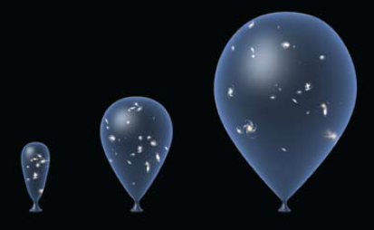
More on the Big Bang
The Universe started as intense heat (10³² K) and is cooling as it expands
The Universe was compressed into zero volume (having infinite density) ~ 13.7 billion years ago
The Universe started as energy, condensing to simple particles first, then to more complex particles as the temperature fell
Gravity acted to form stars and galaxies
Notes:
The initial temperature of the Universe was too high to allow particles as we know them to exist. Their component parts (quarks) were too energetic to allow any forces of attraction between them to bind them together. As the temperature fell, quarks combined to give hadrons (protons and neutrons).

Slide 7
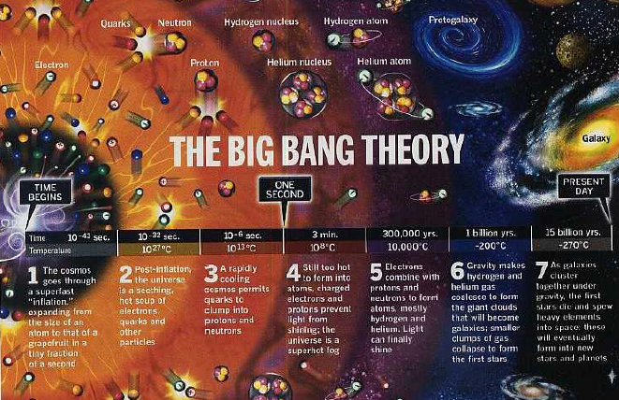

Slide 8
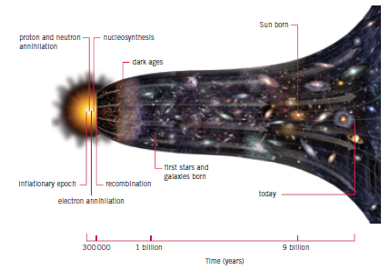
Notes:
Antimatter – not dark matter (which comprises 80% of the Universe). Continued acceleration forms part of the evidence for supposing the universe is composed of large amounts of dark matter.

Slide 9
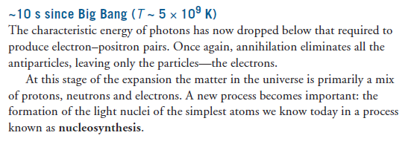
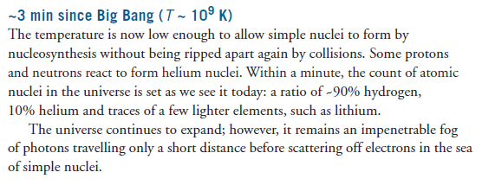

Slide 13
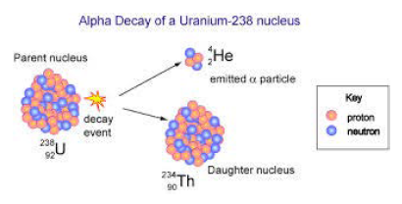
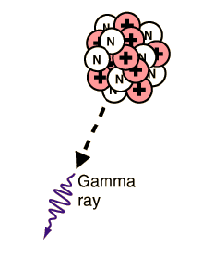
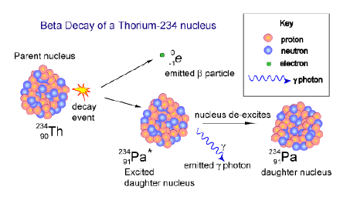

Slide 14
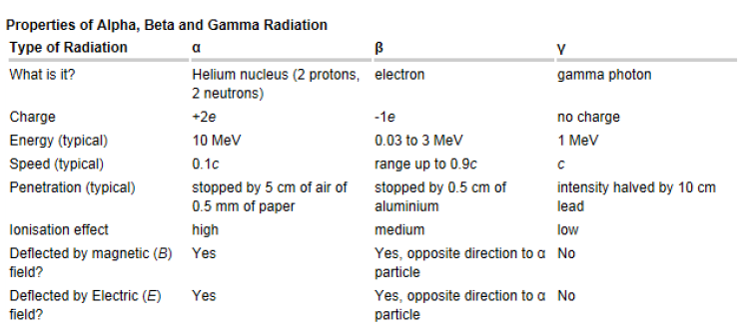
Notes:
Alpha particles have a charge of +2 electrons (due to the two protons) and have much more
mass than beta particles. They are far more likely to interact with matter and knock electrons
out of their orbits—causing ionisation easily but with little penetrating power. They are
deflected when moving through electric and magnetic fields, as a force is exerted on moving
charges in these fields.
(b) Beta particles, electrons, have a charge of –1 and very little mass. They can still knock electrons
out of their orbits but are less likely to do so. They can penetrate matter better than the larger,
more massive, alpha particles. With less mass, they are deflected far more than alpha particles
when moving through electric or magnetic fields, but in the opposite direction as their charge is
opposite.
(c) Gamma rays are not particles and do not have charge. They interact weakly with matter and
so can penetrate much further than beta particles; however, without mass, it is more difficult
for gamma rays to cause ionisation. Without charge, they are unaffected by electric or magnetic
fields.

Slide 16
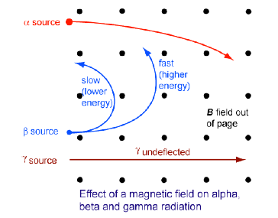
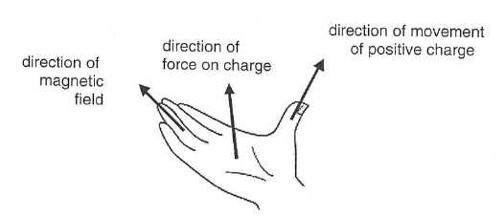

Slide 17
Luminosity and brightness
A star’s luminosity is its total energy output (W).
A star’s brightness (or irradiance) is measured in Wm⁻²: $Brightness= \frac{luminosity}{4πd^{2}}$
The brightness ratio of two objects with the same luminosity is given by the square of the ratio of their distances: $\frac{b_{1}}{b_{2}}={\left(\frac{d_{2}}{d_{1}}\right)}^{2}$
Notes:
Compare with I = P / A !

Slide 19
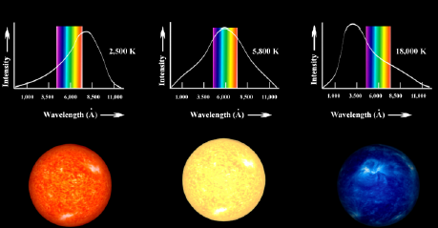
Star colour and temperature
Notes:
Blackbody or Planck curves

