Slide 1
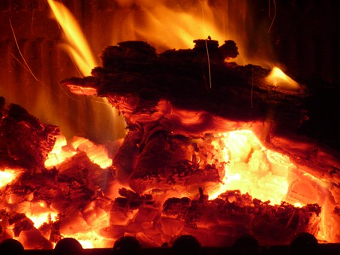
Heat, light and sound

Slide 2
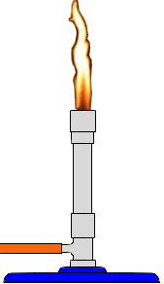
A demonstration – balloon fun
Predict, Observe, Explain
Air filled
Water & air filled
Notes:
Air inside the balloon (1) doesn’t absorb heat from the flame. The balloon becomes weaker where the flame heats it, and breaks at this point.
Water inside the balloon (2) absorbs a lot of the heat energy that is transferred to the balloon. Sets up convection current. It takes a lot of energy for the temperature of the water to rise so that the balloon is affected. (Heat capacity – 4.18 J mL-1 g-1 – due to hydrogen bonding)

Slide 3
Review of particle model
Heat is a form of energy that can be transferred through solids, liquids and gases. The particle model helps to explain this!
Notes:
Emphasise what a model is.

Slide 4
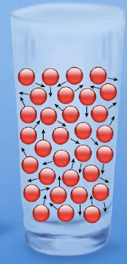
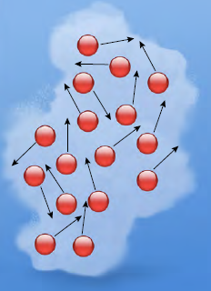
Particle model continued
How is the motion of atoms and molecules in a solid like people in a movie theatre?
How does the motion of people at an outdoor rally resemble a liquid?
How are the behaviour and arrangements of gas molecules similar to and different from soccer players running around?
Notes:
In a gas, particles are moving around at hundreds of kms per hour.

Slide 5
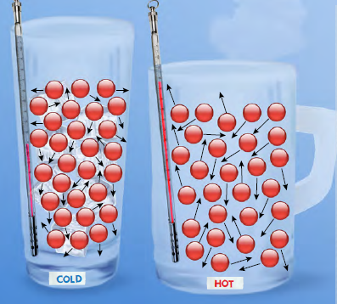
Thermal energy (heat) and temperature
Thermal energy (or heat energy) the energy possessed by an object due to the collective movement of particles within the object
Temperature is a measure of the average kinetic energy of the particles and can be measured with a thermometer
When a hot object is put beside a colder object, heat is transferred from the hot object to the colder object
Notes:
Q: What happens when all motion stops? What is the temperature then?
Q: Can someone explain how a thermometer might work?

Slide 6
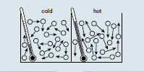
Heat transfer
1
2
3
4

Slide 7
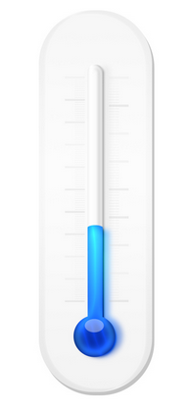
Expansion, contraction
The particles in a solid vibrate more when heated. This causes the solid to expand.
The particles of a gas travel faster when heated. They hit the sides of the container more frequently and with more force. A balloon has flexible walls so this force will cause it to expand.
Expansion
Contraction

Slide 8
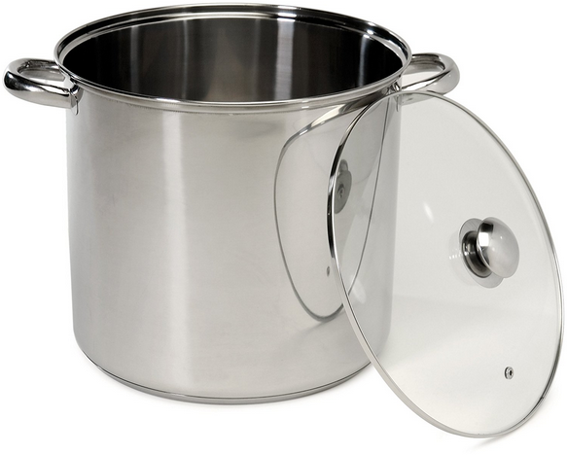
Heat and temperature again
T_{big} = T_{small}
V_{big} > V_{small}
H_{big} > H_{small}

Slide 9
Heat transfer - conduction

Slide 10
Conduction continued
Materials that allow heat to transfer through them are called CONDUCTORS
Materials that do not allow heat to transfer through them are called INSULATORS
Q: Why aren’t cooking pans made of plastic?
Notes:
Q: What are some examples of good conductors and poor conductors (insulators)
Conductors – metals (Cu, Al), glass (pyrex)
Insulators – plastic, cloth, wood, cork, air, polystyrene, rubber, asbestos
Q: What about puffer jackets – how do they work? Or doonas. (Trapped air).

Slide 11
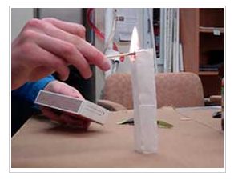
A demonstration – teabag fun
Predict, Observe, Explain
Notes:
What happens if we light the teabag from the bottom?

Slide 12
Conduction, convection and radiation

Slide 13
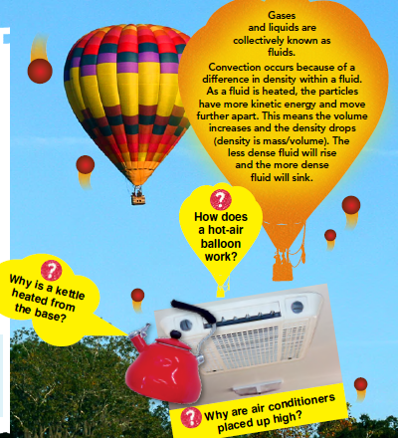
Heat transfer - convection
Examples:
A sea breeze during the day A land breeze at night
Hot water systems

Slide 14
Heat transfer - radiation
Radiation transmits heat as invisible waves that travel at the speed of light. Infrared radiation is heat energy that is transmitted in this way
All objects emit (release) some infrared radiation
The hotter something is, the more heat it radiates. (Think of standing near a hot oven or fire)
When radiation hits a surface, the heat may be absorbed, reflected or transmitted through the surface (dark, light and clear materials)

Slide 15
What have we discussed?
Particle model
Heat transfer, temperature, thermal energy
Convection, conduction and radiation

